Slide 1
JUNGLE JOLT GAME EXPLANATION

Slide 2
CONTENTS OF THIS EXPLANATION
Here s what we will go through in this presentation:
Firstly, we will see the necessary libraries that has to be imported.
So, we will go through the classes present in our code one by one.
While going through the classes we will see te working of their fucntions like what they are actually doing.
Then we will move towards the end where we will be calling the functions that we have defined in our code.
Finally we will see our main function.

Slide 3
LIBRARIES TO BE IMPORTED
OS
Sys
1
2
Pygame
Pickle
3
4

Slide 4
01
Libraries & Setup

Slide 5
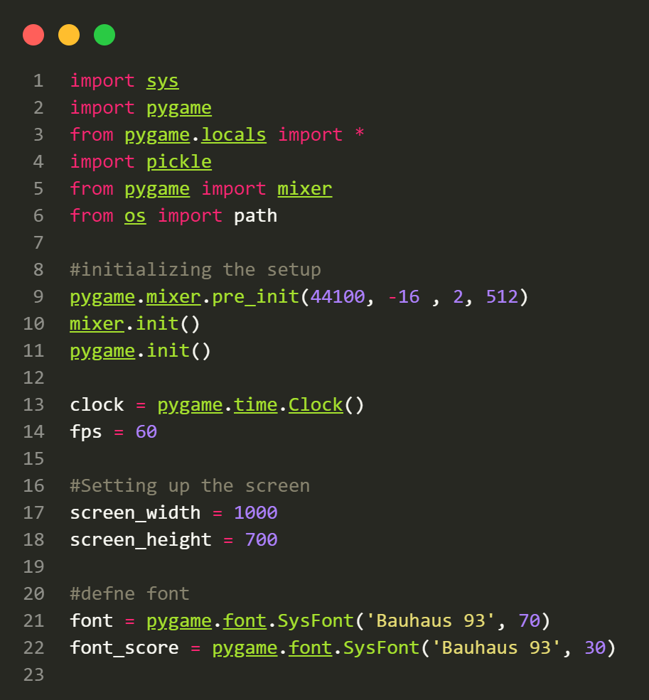

Slide 6
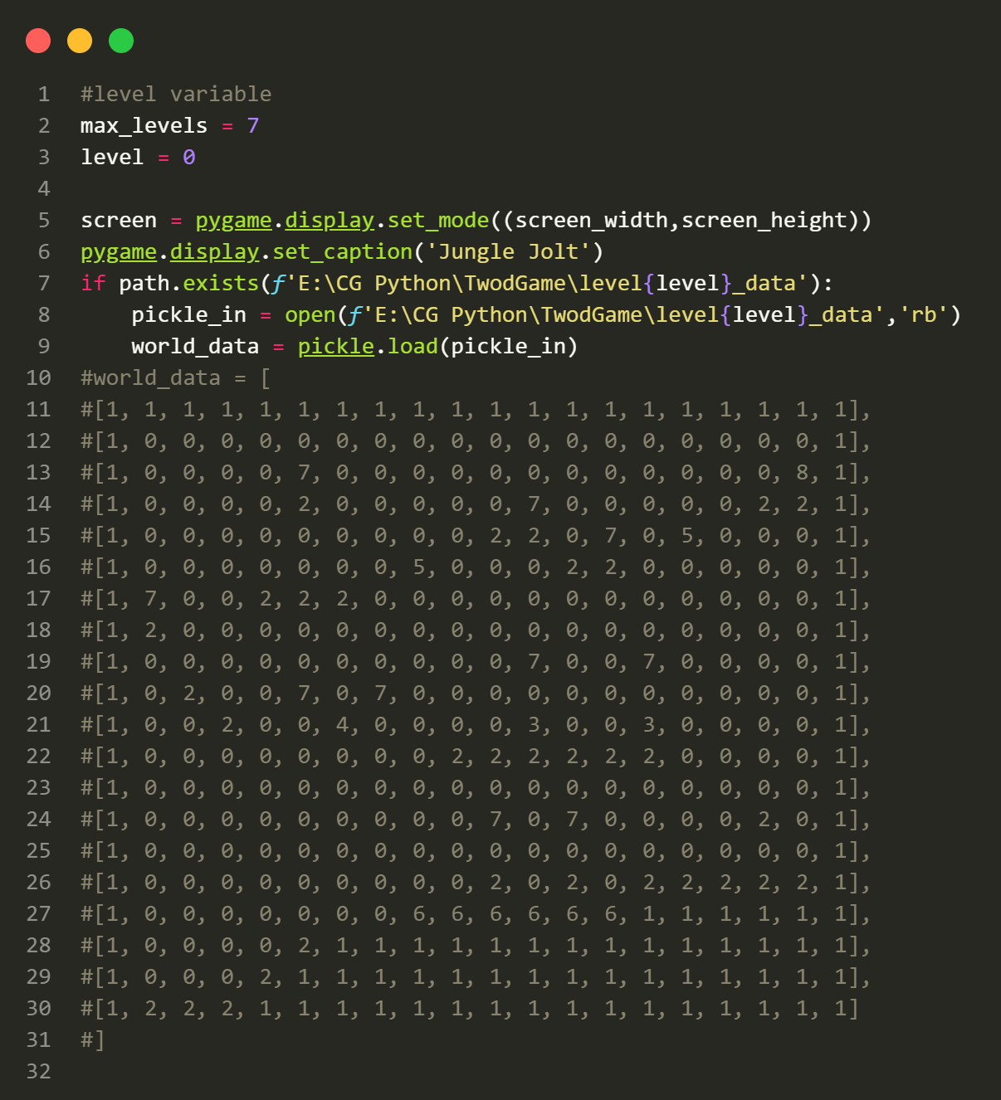

Slide 7
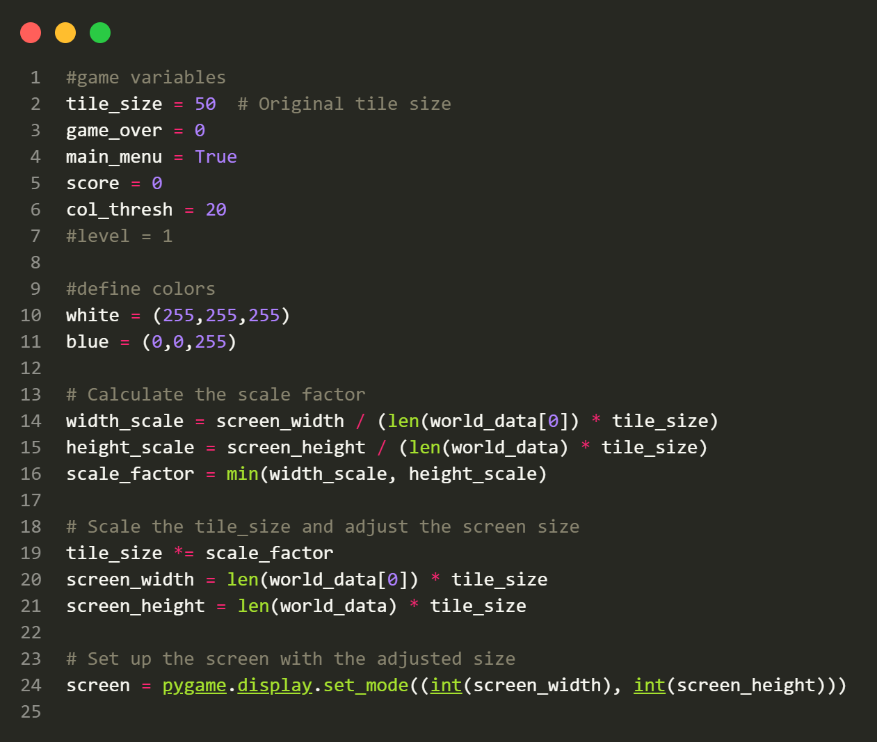

Slide 8
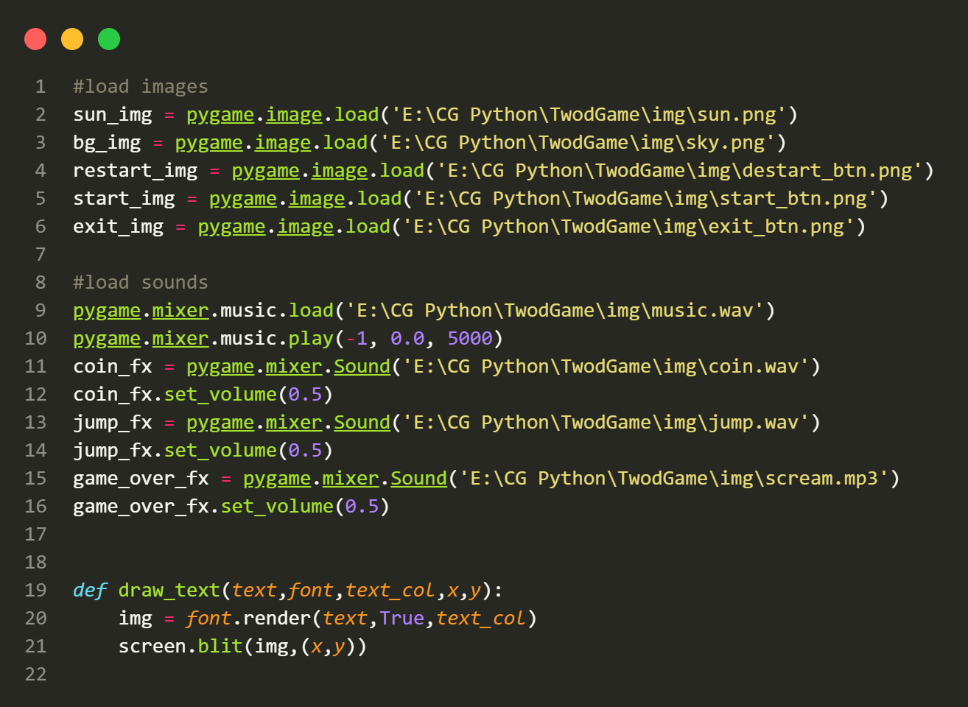

Slide 9
- Importing Libraries:
- import sys: Imports the Python sys module for system-related operations.
- import pygame: Imports the pygame library for game development.
- from pygame.locals import *: Imports specific constants and functions from the pygame.locals module.
- import pickle: Imports the pickle module for serializing and deserializing data.
- from pygame import mixer: Imports the mixer module from pygame for handling sound.
- from os import path: Imports the path module from the os library for handling file paths.
- Initializing Pygame:
- pygame.mixer.pre_init(44100, -16 , 2, 512): Pre-initializes the mixer with specific audio settings.
- mixer.init(): Initializes the mixer module for sound.
- pygame.init(): Initializes the pygame library.

Slide 10
- Setting Up Game Clock and FPS:
- clock = pygame.time.Clock(): Creates a Pygame clock object for controlling frame rate.
- fps = 60: Defines the target frames per second for the game.
- Setting Up the Game Screen:
- Defines the dimensions of the game screen using screen_width and screen_height.
- Creates a Pygame screen surface using `pygame.display.set_mode()` with the specified screen dimensions.
- Sets the window title using pygame.display.set_caption().

Slide 11
02
CLASS Button
You can enter a subtitle here if you need it

Slide 12
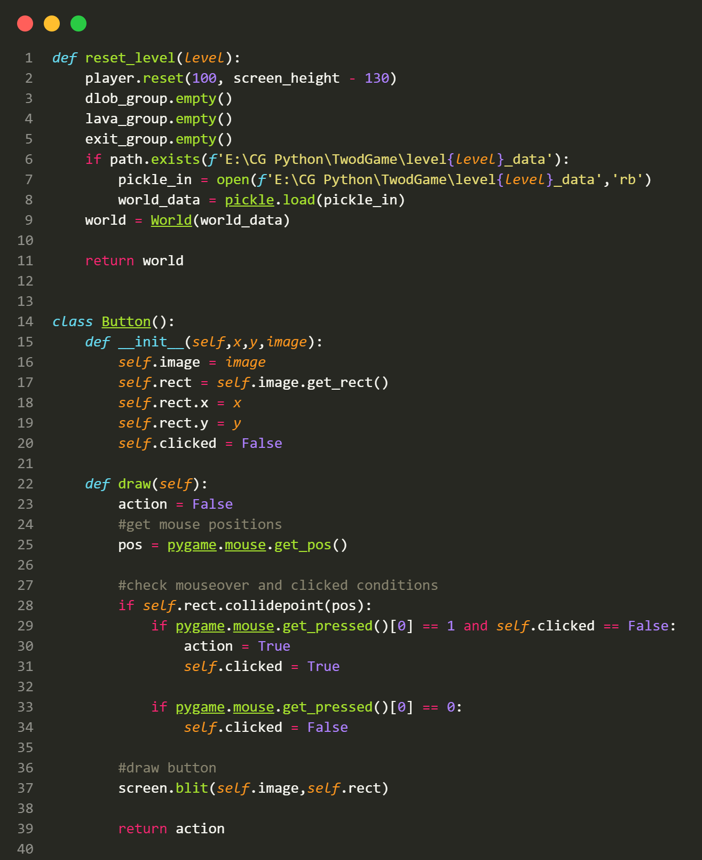

Slide 13
This class is used to create interactive buttons in the game.
Attributes:
image: The image representing the button.
rect: The rectangular area that defines the button s position and size on the screen.
clicked: A boolean flag to track whether the button has been clicked.
Methods:
__init__(self, x, y, image): Initializes the button with its position and image.
draw(self): Draws the button on the screen and detects if it has been clicked by the user.

Slide 14
03
CLASS Player

Slide 15
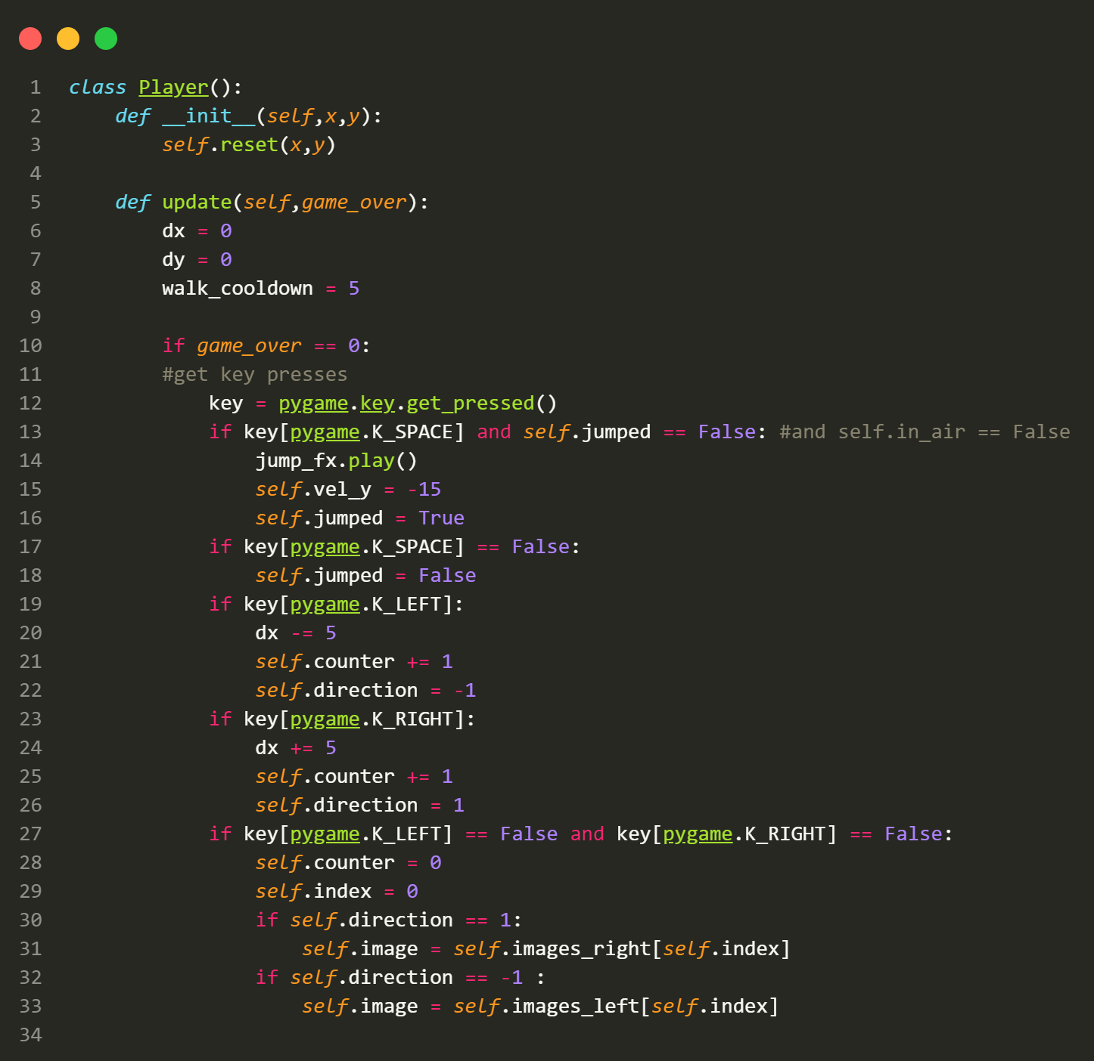

Slide 16
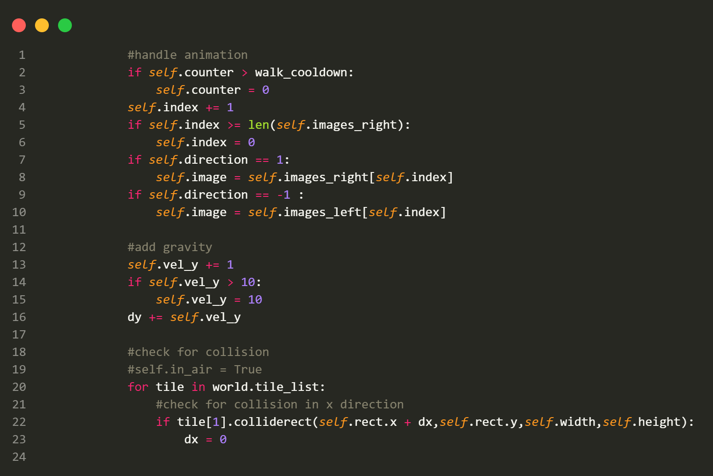

Slide 17
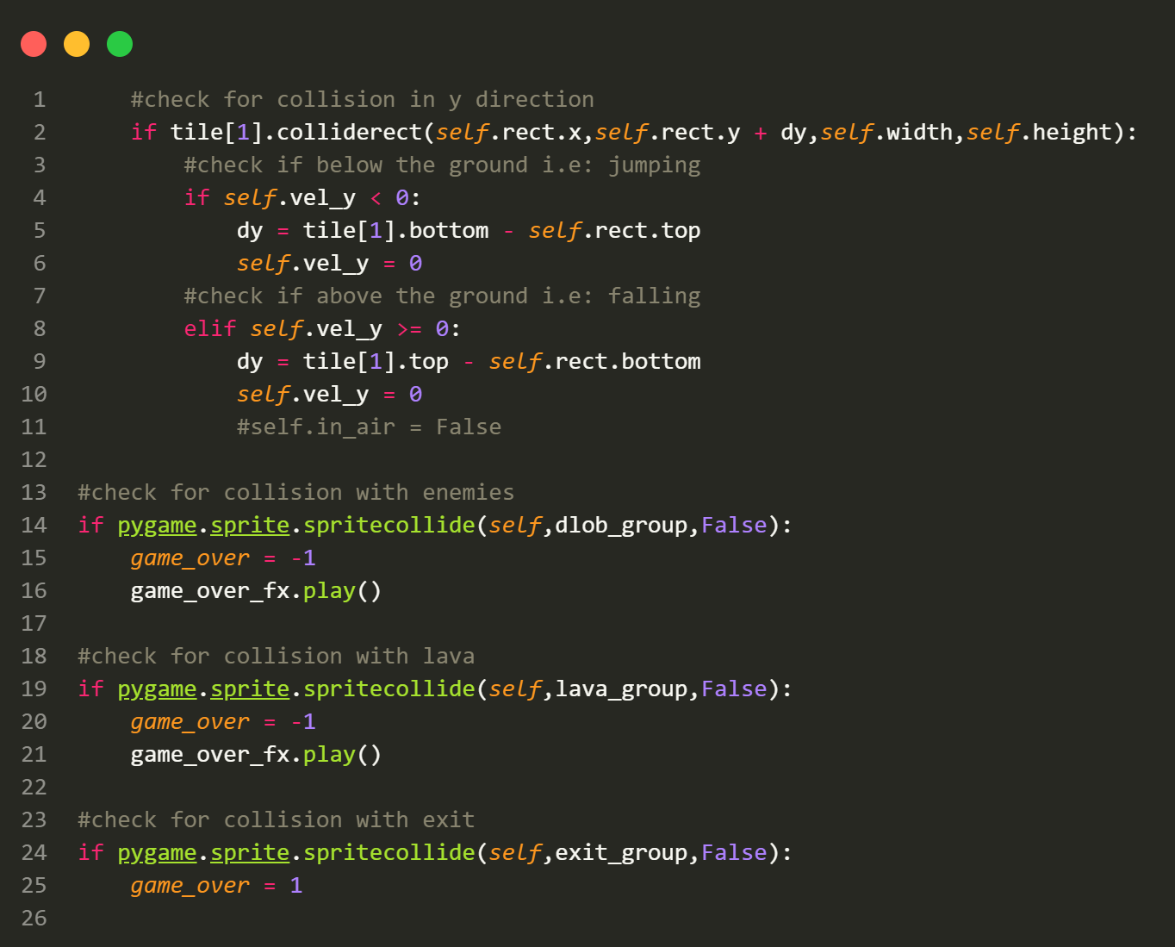

Slide 18
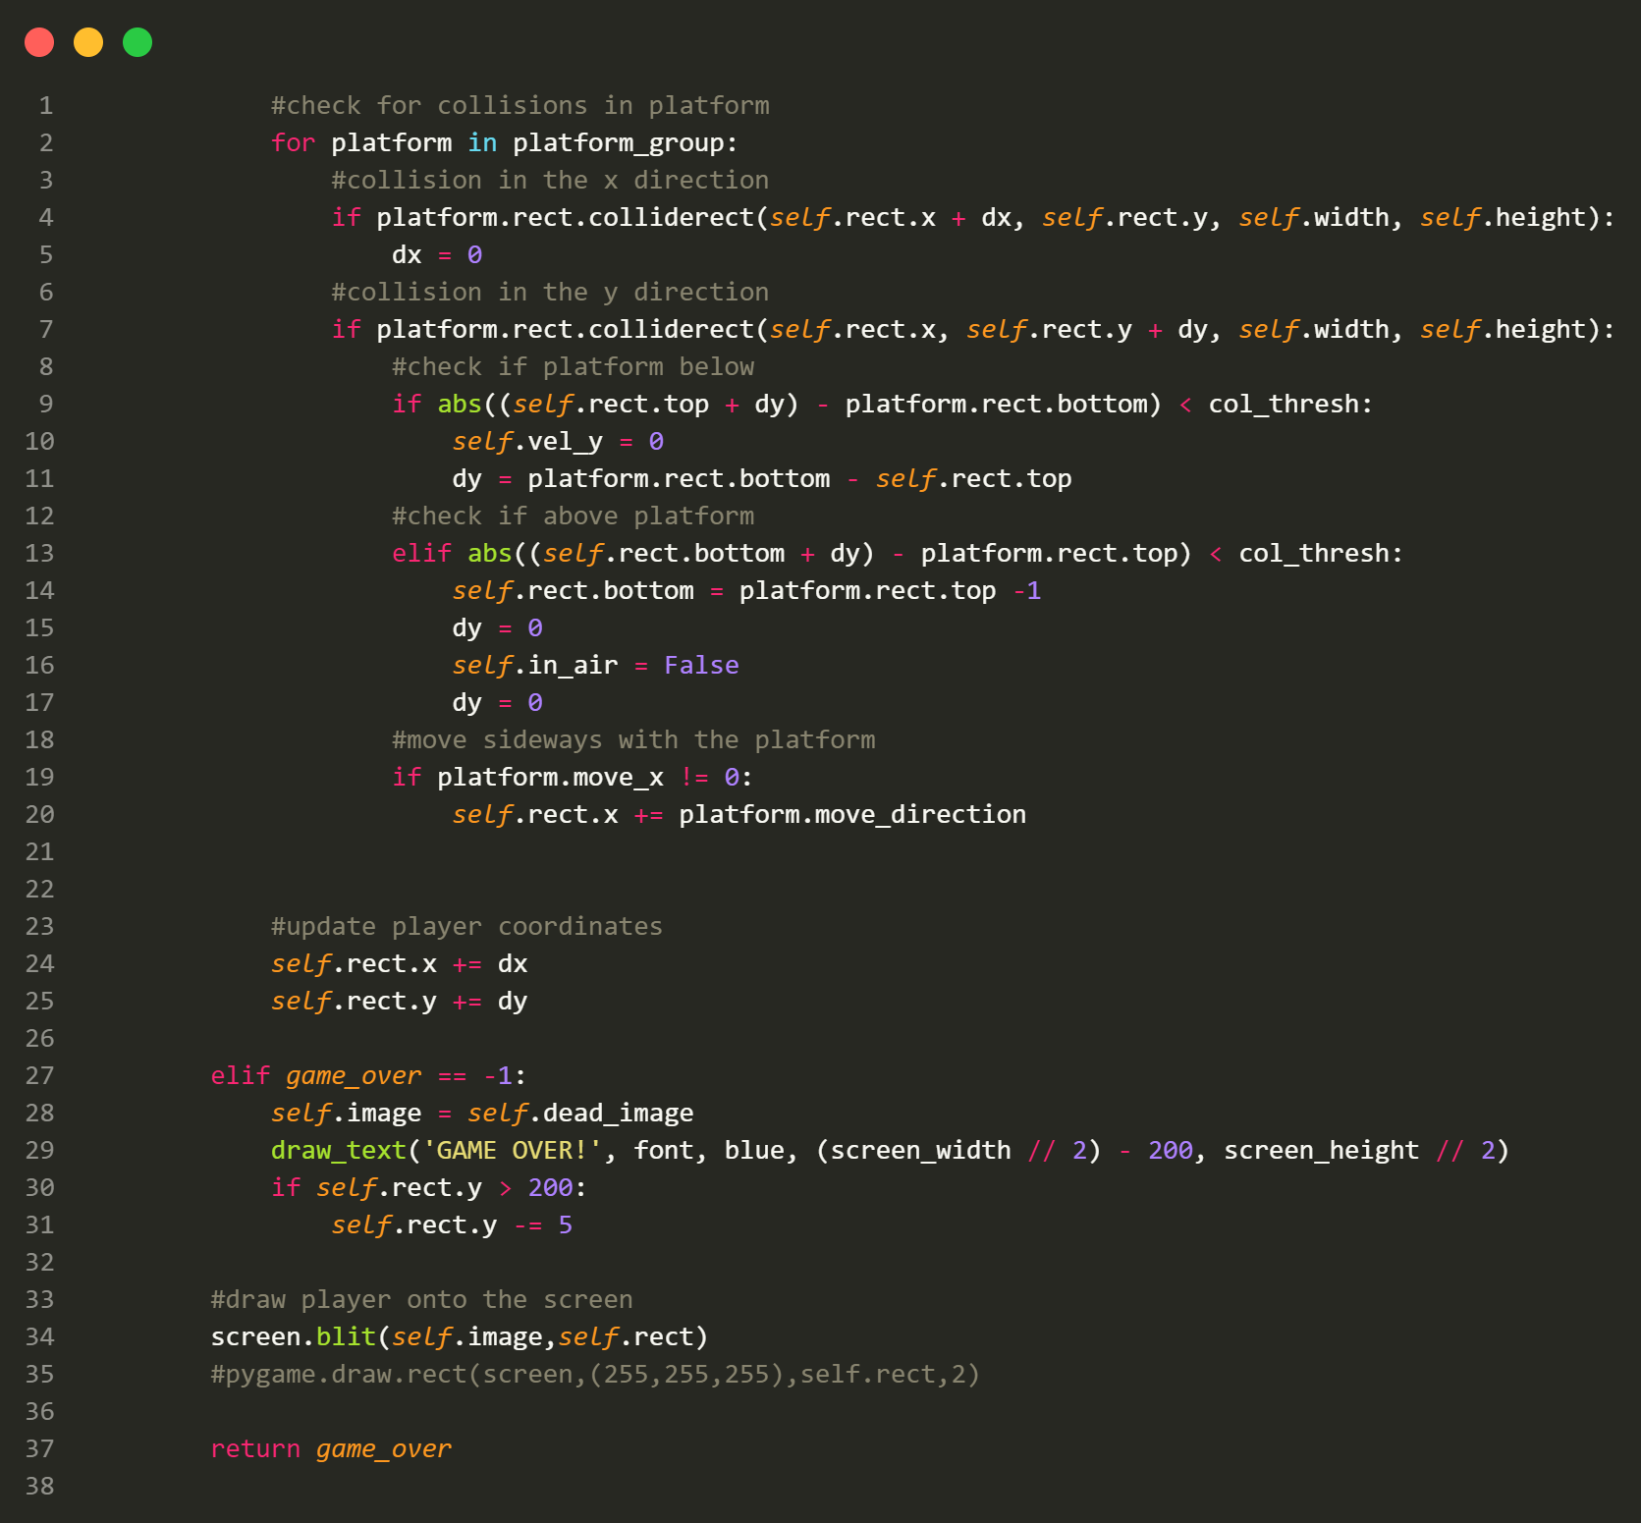

Slide 19
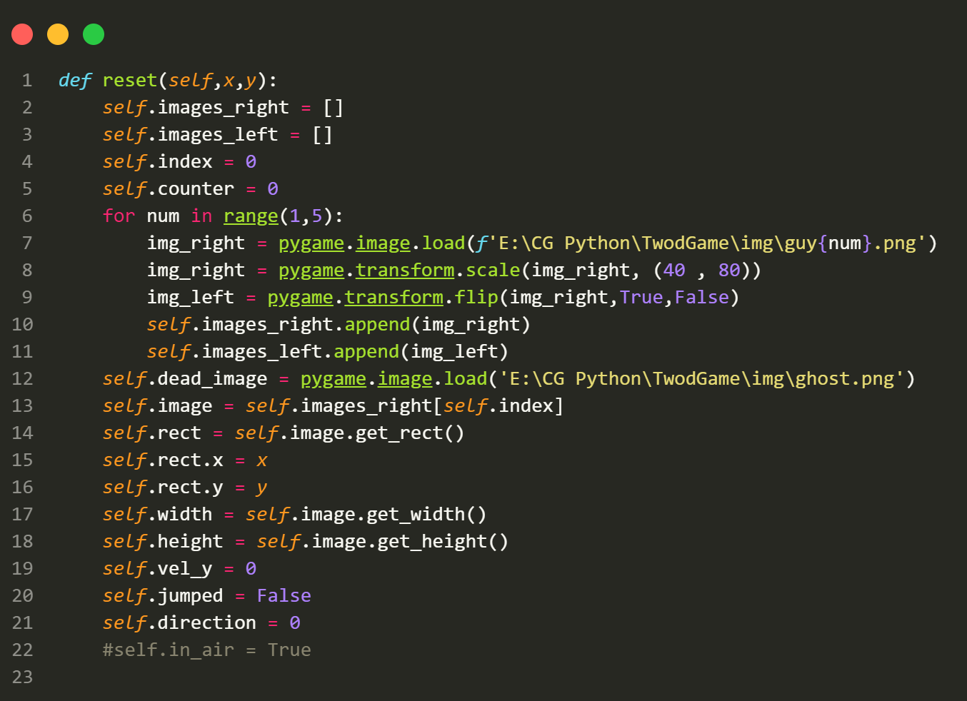

Slide 20
This class represents the player character in the game.
Attributes:
Various attributes for character properties, such as images for different animations,
position, velocity, and state.
Methods:
__init__(self, x, y): Initializes the player character at a given position.
update(self, game_over): Updates the character s position, animations, and collision detection based on
user input and game state.
reset(self, x, y): Resets the player s position and attributes.

Slide 21
04
CLASS World

Slide 22
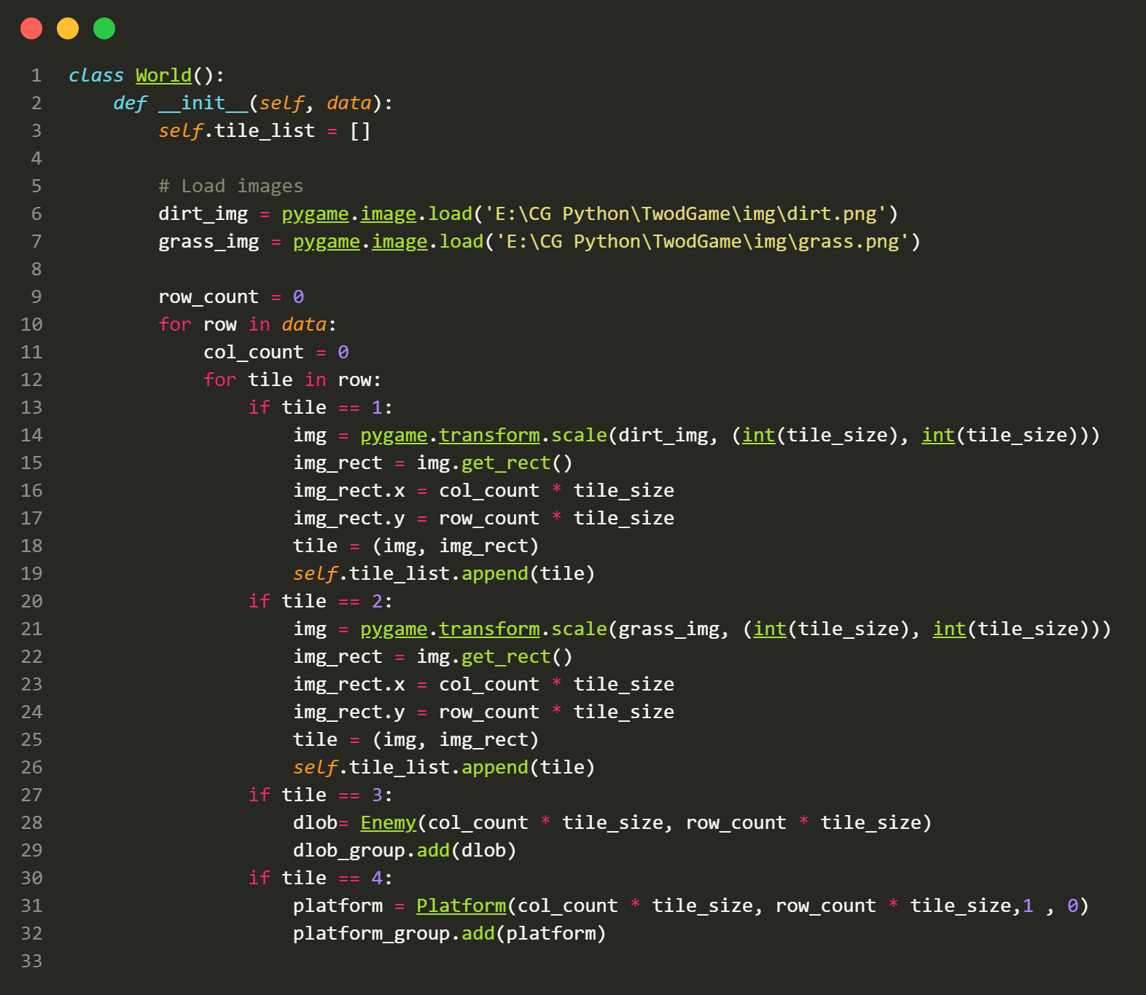

Slide 23
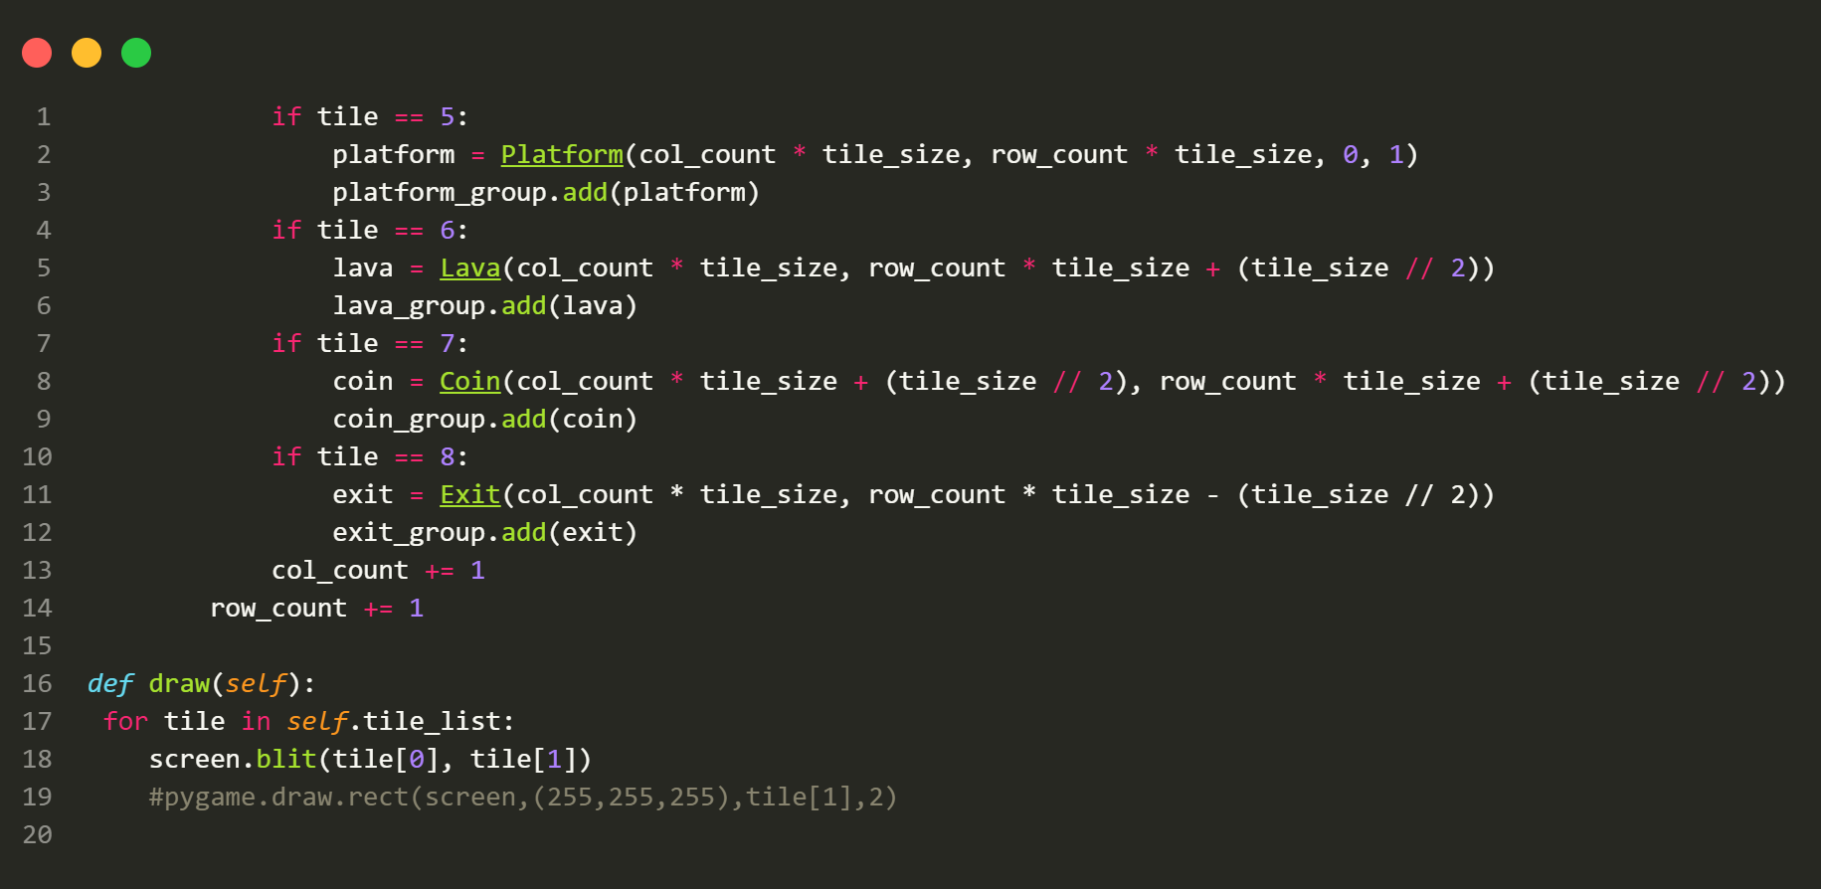

Slide 24
This class represents the game world, including the terrain and objects.
Attributes:
tile_list: A list that stores tuples of images and their positions representing the terrain.
Methods:
__init__(self, data): Initializes the world with level data.
draw(self): Draws the terrain and objects on the screen.

Slide 25
05
CLASS Enemy

Slide 26
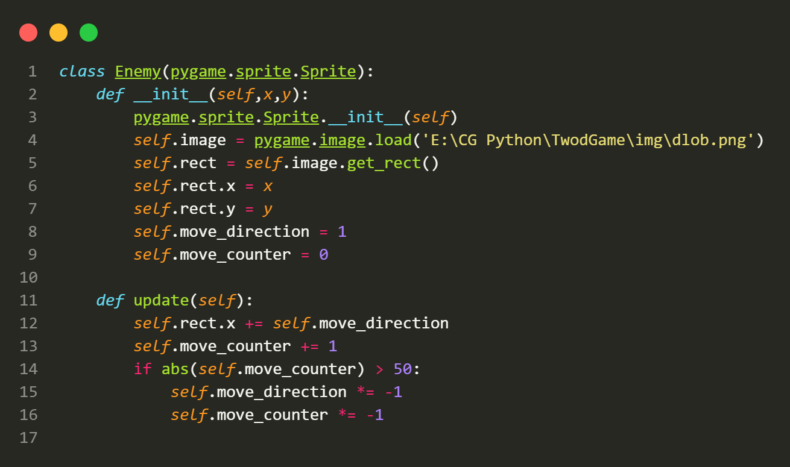

Slide 27
This class represents enemy characters in the game.
Attributes:
image: The image representing the enemy.
rect: The rectangular area defining the enemy s position and size on the screen.
move_direction: The direction in which the enemy is currently moving.
move_counter: A counter used to change the enemy s direction after a certain number of frames.
Methods:
__init__(self, x, y): Initializes the enemy character at a given position.
update(self): Updates the enemy s position and movement direction.

Slide 28
06
CLASS Platform

Slide 29
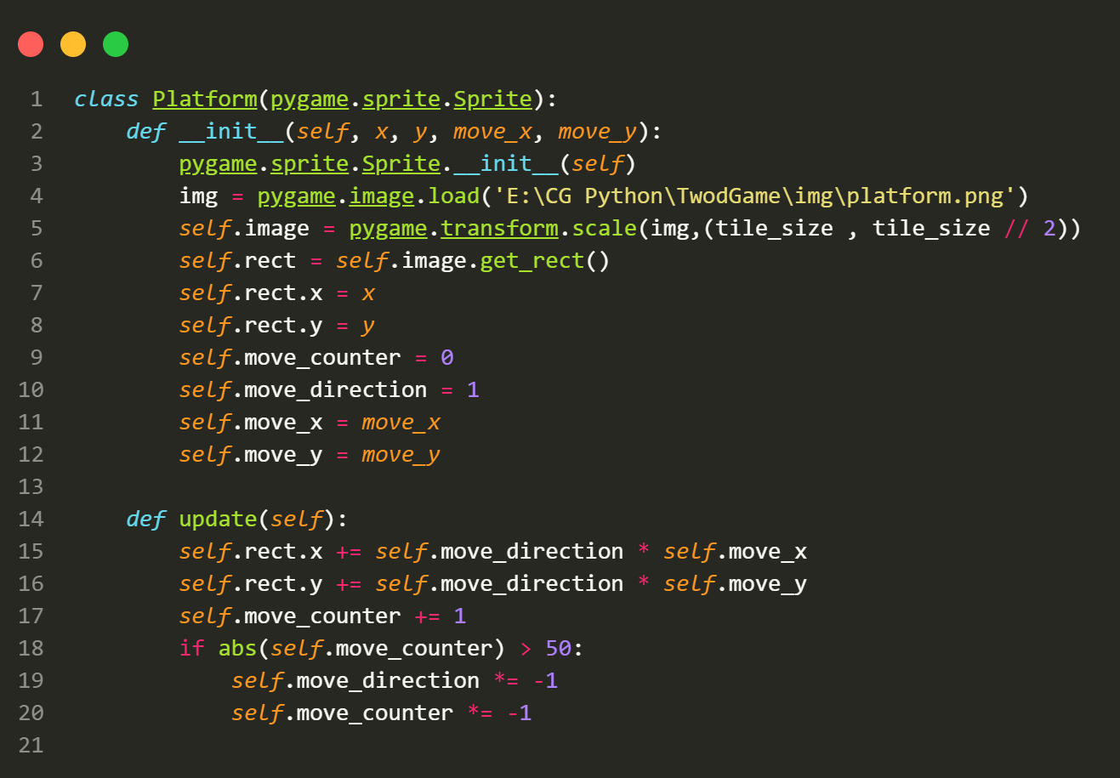

Slide 30
This class represents platforms in the game that the player can stand on.
Attributes:
image: The image representing the platform.
rect: The rectangular area defining the platform s position and size on the screen.
move_direction: The direction in which the platform is currently moving (if any).
move_counter: A counter used to change the platform s direction after a certain number of frames.
move_x and move_y: The amount by which the platform moves in the x and y directions.
Methods:
__init__(self, x, y, move_x, move_y): Initializes the platform at a given position with optional movement
parameters.
update(self): Updates the platform s position and movement direction.

Slide 31
07
CLASS Lava ,Coin & Exit

Slide 32
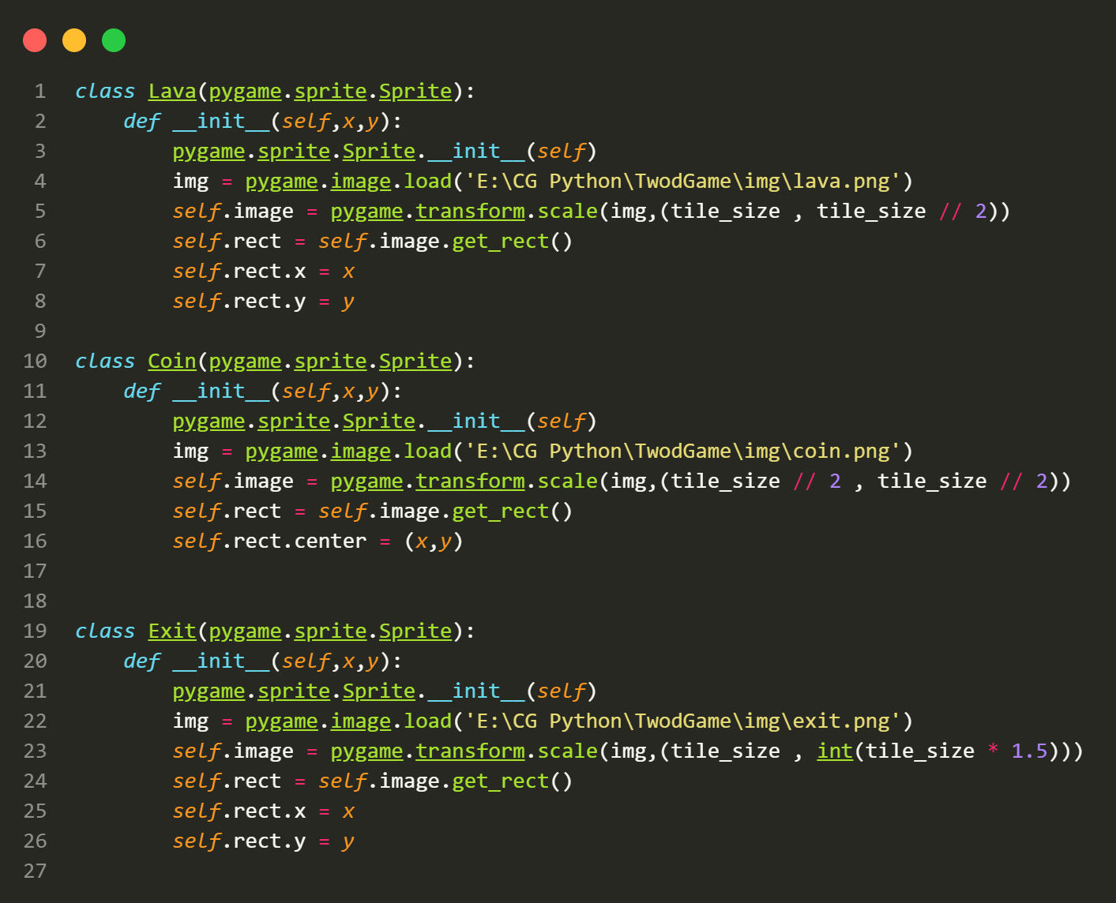

Slide 33
Lava Class:
This class represents lava obstacles in the game.
Attributes:
image: The image representing the lava obstacle.
rect: The rectangular area defining the lava s position and size on the screen.
Methods:
__init__(self, x, y): Initializes the lava obstacle at a given position.
Coin Class:
This class represents collectible coins in the game.
Attributes:
image: The image representing the coin.
rect: The rectangular area defining the coin s position and size on the screen.
Methods:
__init__(self, x, y): Initializes the coin at a given position.
Exit Class:
This class represents the exit point in the game that the player must reach to complete the level.
Attributes:
image: The image representing the exit point.
rect: The rectangular area defining the exit point s position and size on the screen.
Methods:
__init__(self, x, y): Initializes the exit point at a given position.

Slide 34
08
Instances & Game Loop

Slide 35
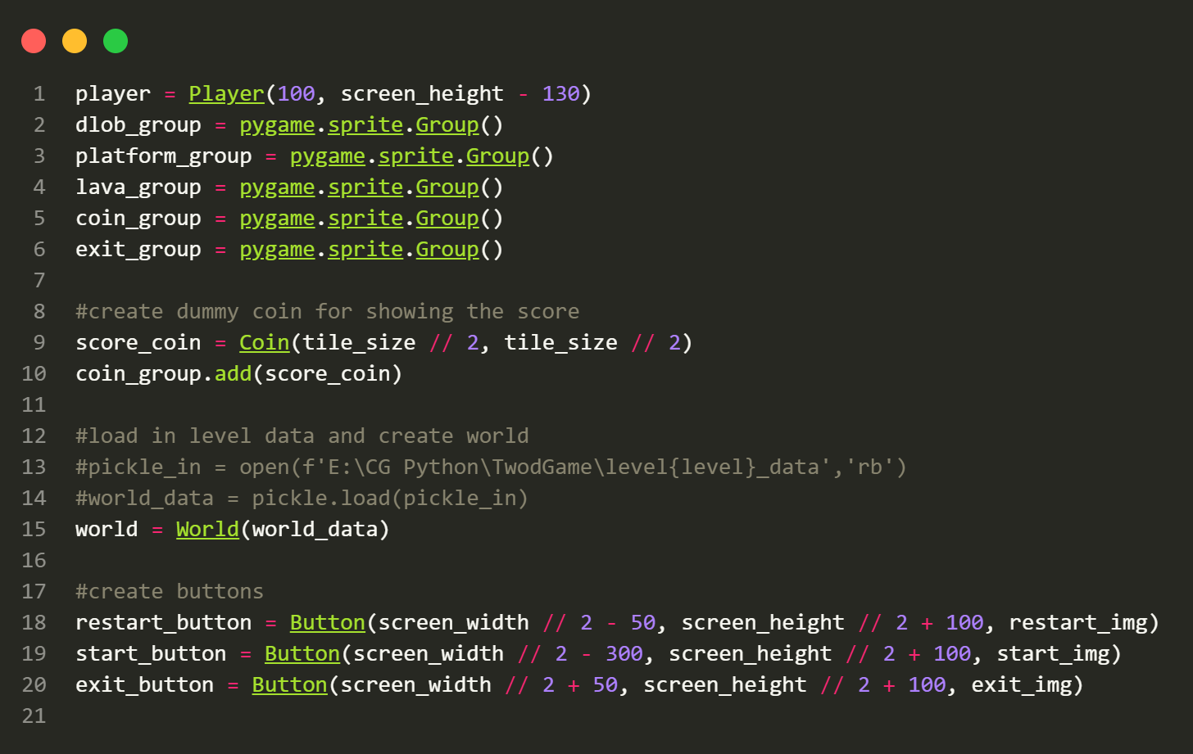

Slide 36
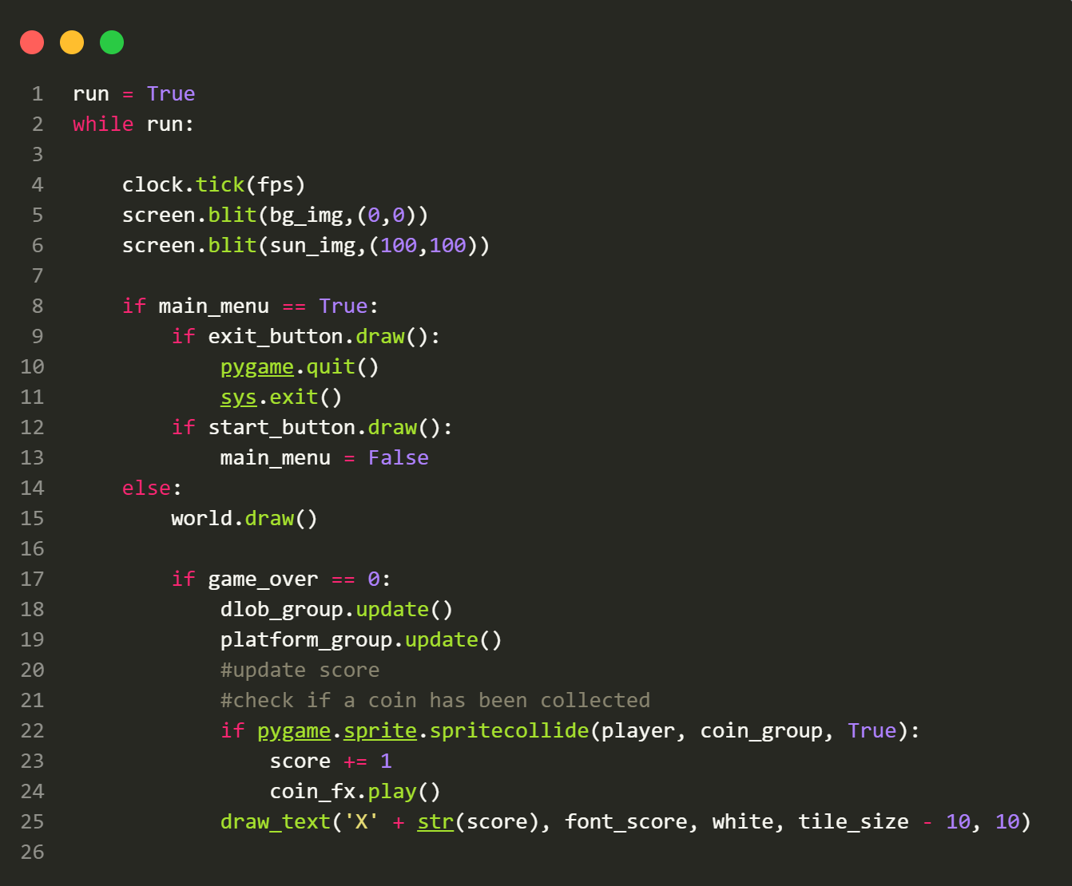

Slide 37
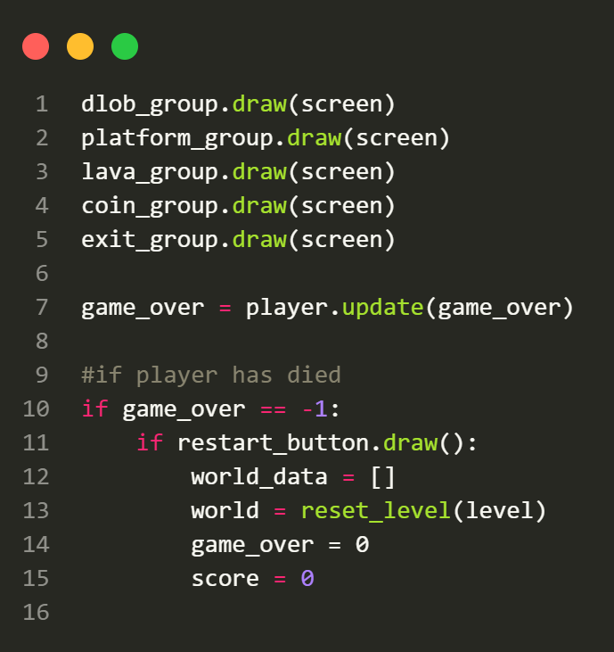

Slide 38
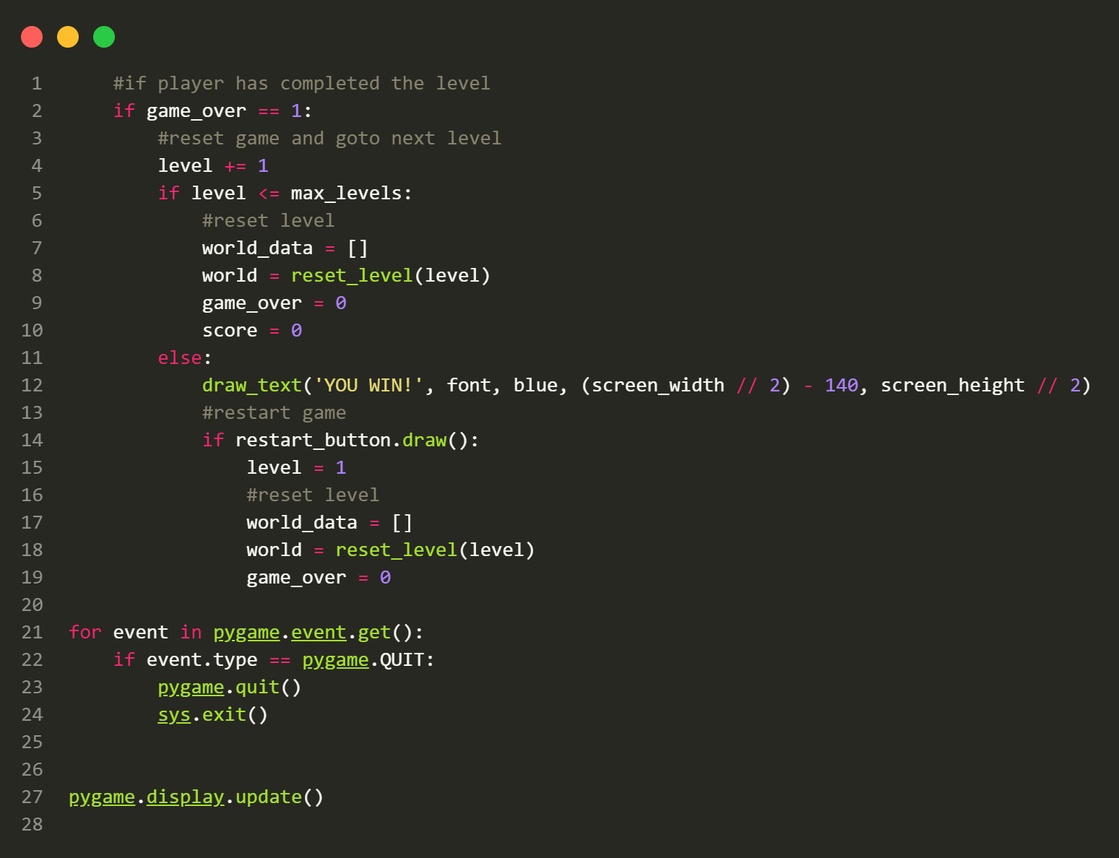

Slide 39
- Creating Instances:
- Creates instances of the `Player` class and various sprite groups for enemies, platforms, lava, coins, and exits.
- Creates a dummy coin for displaying the player s score.
- Game Loop:
- The main game loop runs while the `run` variable is set to `True`.
- Handles user input, updates game elements, and manages game states (main menu, gameplay, game over, level completed).
- Draws game elements on the screen, including the world, characters, buttons, and score.
- Responds to events such as quitting the game.

Slide 40
THANK YOU!

